Slide 1
Database design and Applications CSIZG518/SEZG518/SSZG518)(S1-21)
Uma Maheswari

Slide 2
Tutorial Session
Topic : ER Design Practise.

Slide 3
LEARNING OUTCOME
EER Designing
REFER: T1-Chapter 3 and 4;
Sections:
3.1, 3.3-3.9, 4.1-4.3, 4.6

Slide 4
EER design steps
1. Specialization: extracting a subclass from an entity set.
2. Generalization: combining one or more entity sets into a higher level entity.
a. Disjoint generalization: an entity belongs to at most one lower level entity set.
b. Overlapping generalization: entities may belong to multiple lower level entities.
c. Hierarchy: each entity set is only the object of one “ISA” relationship.
3. Lattice: entity sets may belong to multiple “ISA” relationships.
4. Condition-defined constraint: defines membership in a subclass via a predicate.
User-defined constraint: membership is manually defined.
Completeness constraint: all entities belong to a lower level entity.
Total constraint: all entities belong to lower level entity sets.
Partial Constraint: entities not required to belong to lower level entity set.
5. Aggregation: grouping part of a schema into a larger unit.
6. LOOP from ER1 to EER 5 until design is accepted.

Slide 5
EER design points
When developing an ER diagram presents several choices, including the following:
Should a concept be modelled as an entity or an attribute?
Should a concept be modelled as an entity or a relationship?
What are the relationship sets and their participating entity sets? Should we use
binary or ternary relationships?
Should we use aggregation
UNIONs should be avoided.
• ER design is subjective. There are often many ways to model a given scenario. Analyzing alternatives can be tricky, especially for a large enterprise.
• Common choices include:
Entity vs. attribute
Key for the entity / to store or discard an attribute
Entity vs. relationship
Binary or n-ary relationship
Use of ISA hierarchies (EER )
Use of aggregation

Slide 6
Example 1.
The EER diagram below describes the database of a training center, including information about its members, training activities and bookings.
Each member is identified through his/her e-mail address. Gold-members can book any training activity, while common members can only book core activities.
For each training activity, the database stores the schedule (week, week day, and time), the room, the leader and the e-mail of the leader. Each leader leads several activities per week, but the same activities every week.
Translate the EER diagram into a relational model. Mark each primary key with a straight underline, and each foreign key with a dotted underline. For the foreign keys, mark the attributes that are referred by the foreign keys by means of arrows

Slide 7
Solution

Slide 8
Example 2:
A nonprofit organization depends on a number of different types of persons for its successful operation. The organization is interested in the following attributes for all of these persons: SSN, name, Address, City, State, Zip and Telephone. Three types of persons are of greatest interest: employees, volunteers, and donors. Employees have only a Date Hired attribute, and volunteers have only a Skill attribute. Donors have only a relationship (named Donates) with an Item entity type. A donor must have donated one or more items, and an item may have no donors, or one or more donors. There are persons other than employees, volunteers, and donors who are of interest to the organization so that a person may not belong to any of these three groups and may also belong to more than one group at the same time.

Slide 9
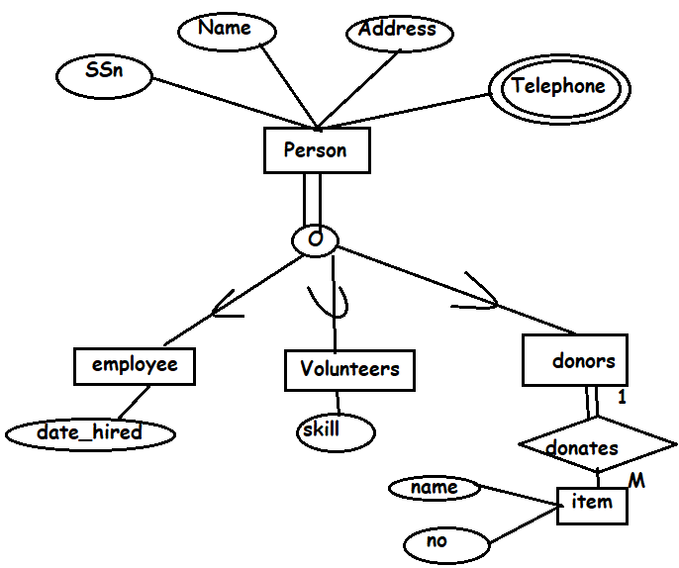
Solution

Slide 10
Example 3
Consider a bank, and model the following two aspects:
• There are three different kinds of ACCOUNTs, namely SAVINGS_ACCTs, CHECKING_ACCTs and TRUSts. For each ACCOUNT we have to take care of its TRANSACTIONs.
Each TRANSACTION has a type such as “deposit”, “withdrawal” or “check”. Furthermore, each transaction has a date/time (consisting of a date and a time) and an amount.
• There are different kinds of LOANS, namely CAR_LOANS, HOME_LOANS, CREDIT_LINE and PERSONAL ones. For each LOAN we have to take care of its PAYMENTs. Each PAYMENT has a type, date and amoun

Slide 11
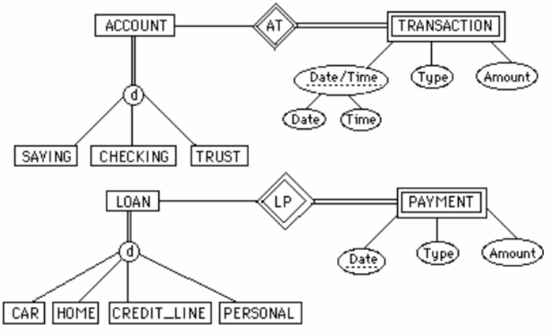
Solution

Slide 12
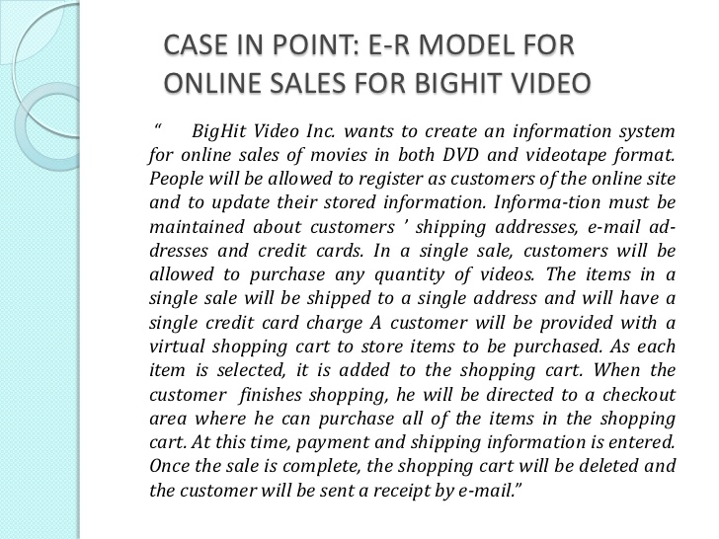
Example 4

Slide 13
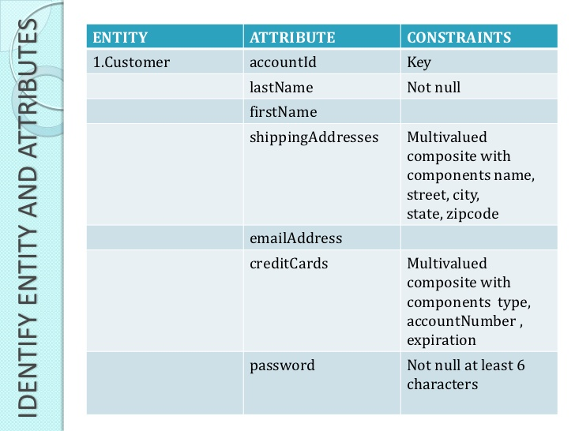
EER Models Design: Example

Slide 14
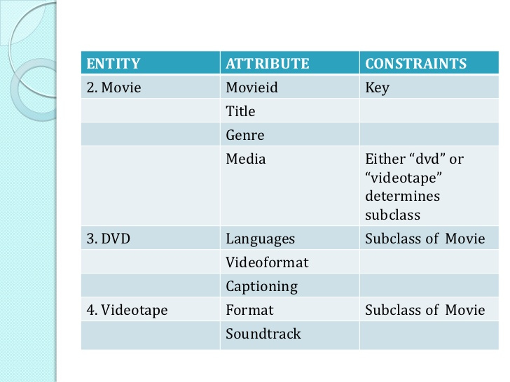
EER Models Design: Example

Slide 15
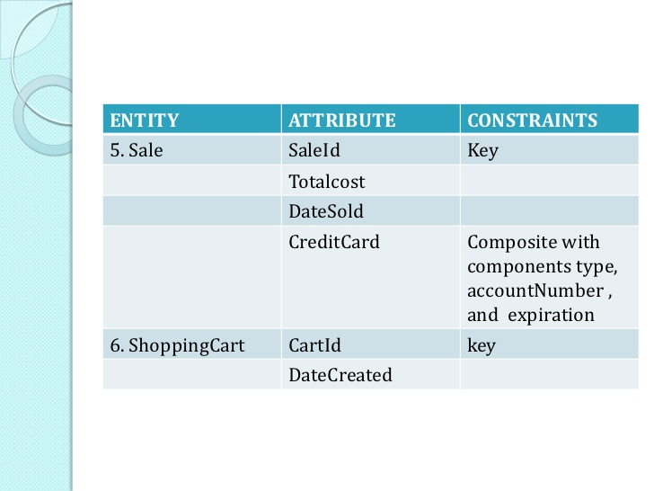
EER Models Design: Example

Slide 16
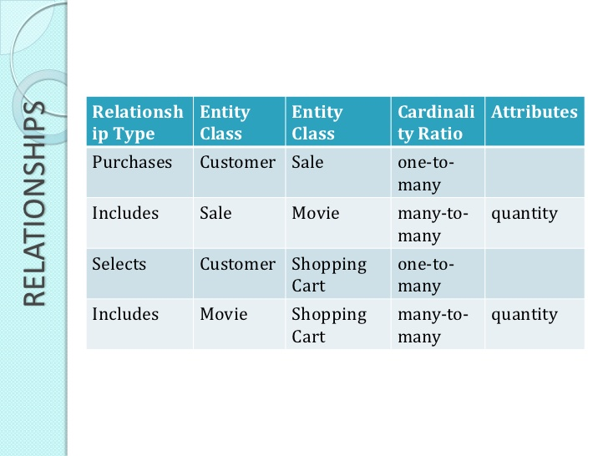
EER Models Design: Example

Slide 17
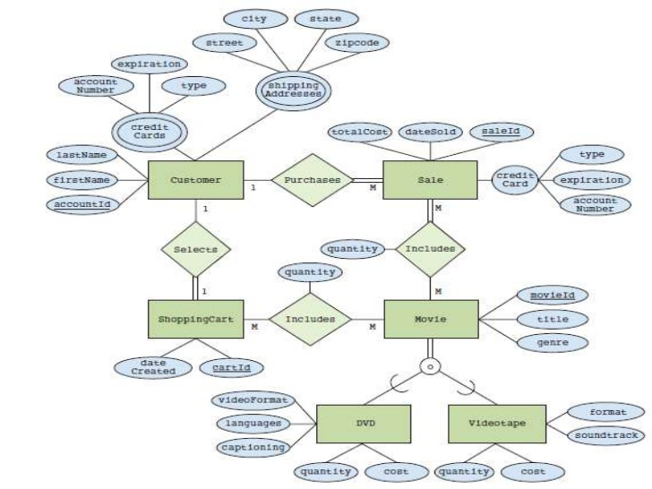
EER Models Design: Example

Slide 18
Practise Practise Practise …..

